Slide 1
OMH Future Roadmap
September 2023

Slide 2
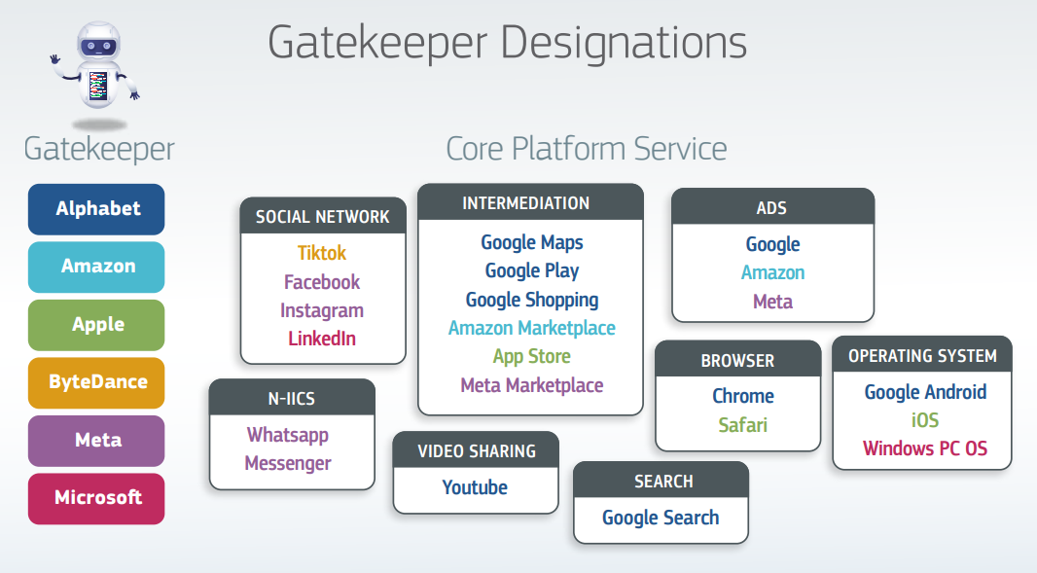


A vision for an open mobile ecosystem Offering more choices to the consumers
Europe
New regulations aim to promote fair and transparent practices in digital markets, to ensure that OEMs, developers and users can benefit equally and have choices. (EU DMA, UK CMA)
US
US Department of Commerce report and recommendations are part of the Biden administration’s push to promote innovation and competition in the mobile app ecosystem.
South Korea
The Korean Fair Trade Commision (KFTC) pushing to allow the use of third-party operating systems.
India
The Competition Commission of India (CCI) fined Google over anti-competitive strategies to dominate the mobile ecosystem in India.
Source : https://www.ntia.gov/report/2023/competition-mobile-app-ecosystem
Source: https://ec.europa.eu/commission/presscorner/detail/en/ip_23_4328

Slide 3
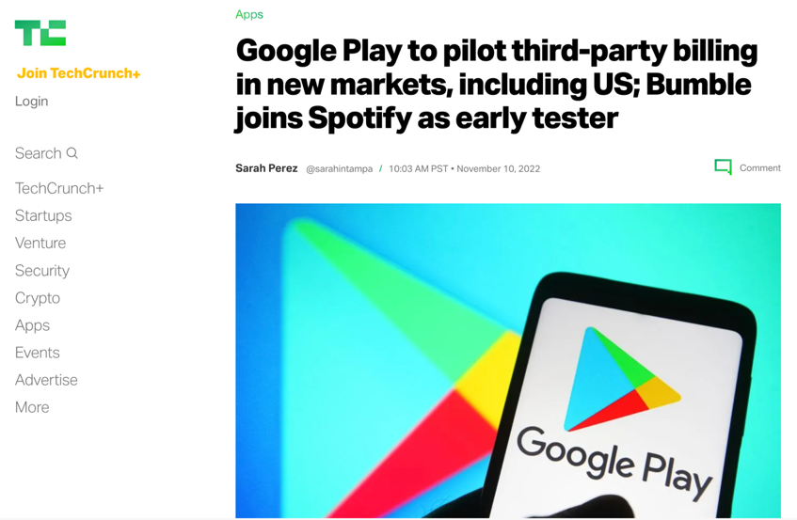
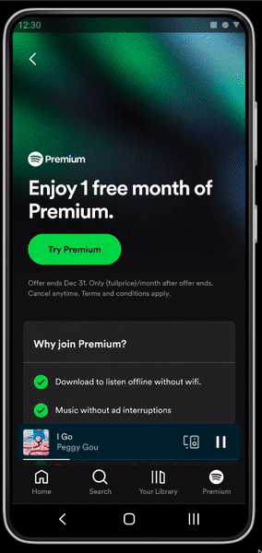
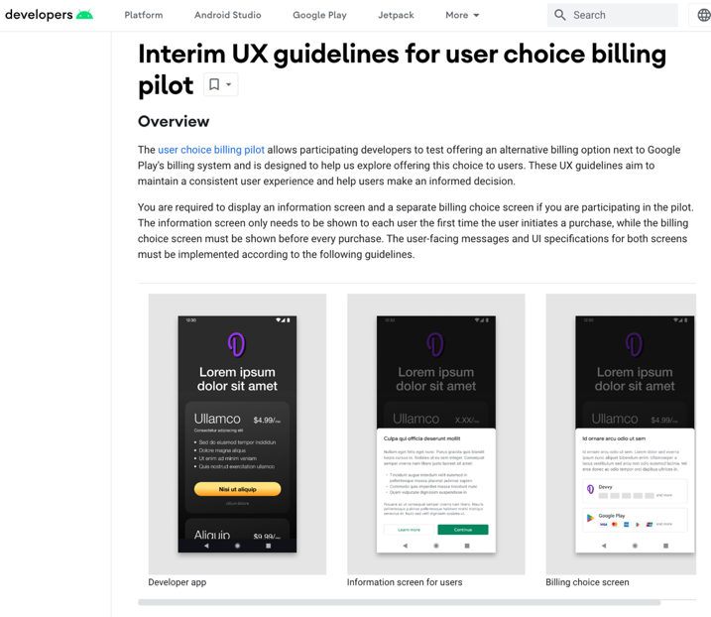
Google Updates to Android and Google Play in India
OEMs can license individual Google apps for preload
Indian users can choose their default search engine
Updating the Android compatibility to build non-compatible or forked variants
User choice billing to choose an alternative billing system
Changes to the Android installation flow and auto-updating capability for sideloaded apps and app stores.
Source : https://blog.google/intl/en-in/updates-to-android-and-google-play-in-india/

Slide 4
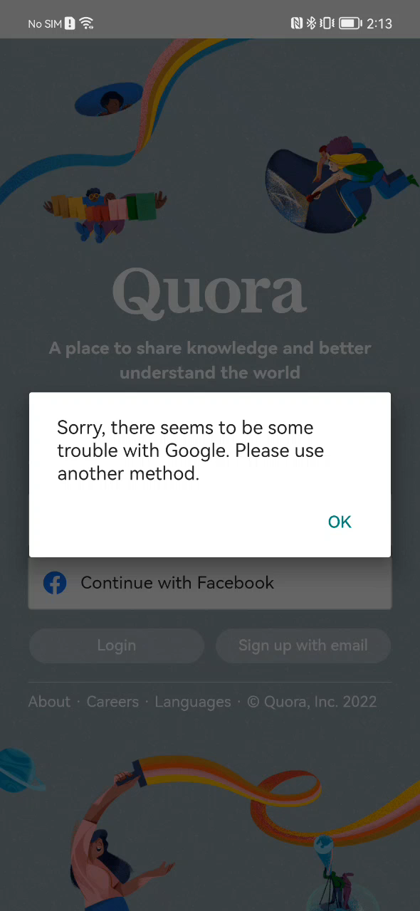
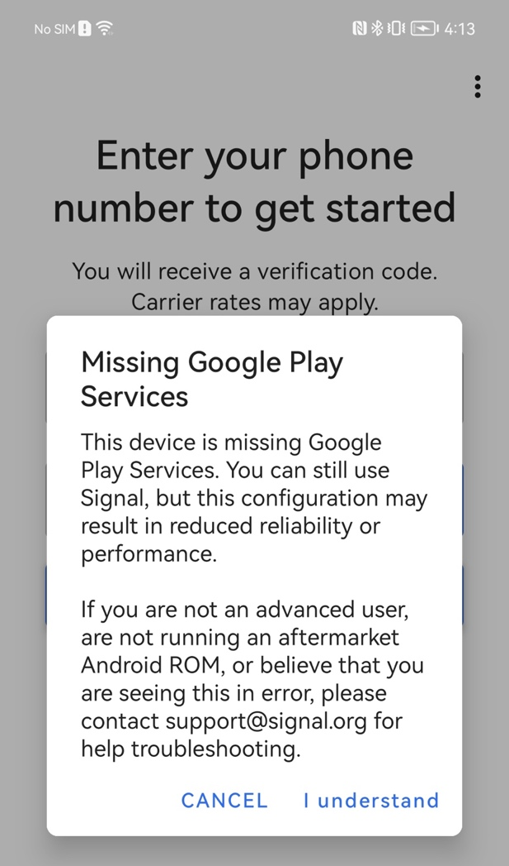
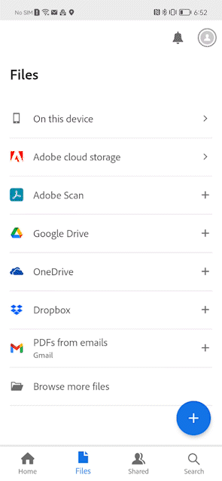
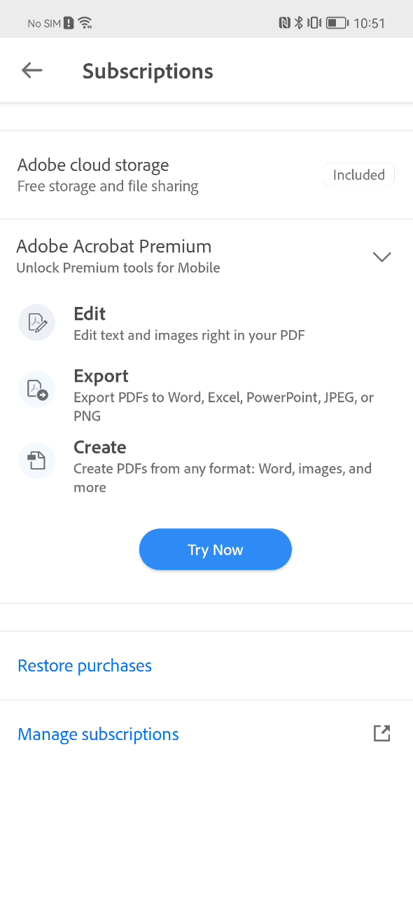
Apps Developers Challenges to Deliver Consistent User Experience
Google Login Authentication
Missing GMS Play Services
Google Drive Access
Google IAP

Slide 5
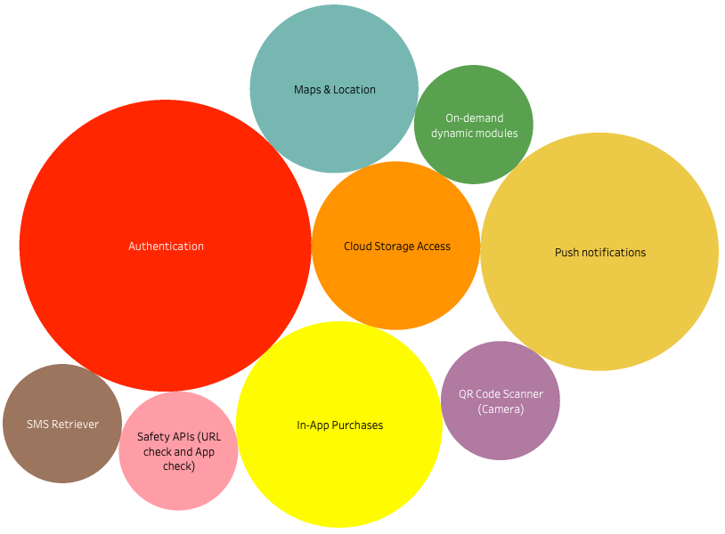
Key Features Impacting Mobile Developers
By understanding which features have the greatest impact, we can prioritize our efforts and focus on addressing the most critical needs of our developer community.
5

Slide 6
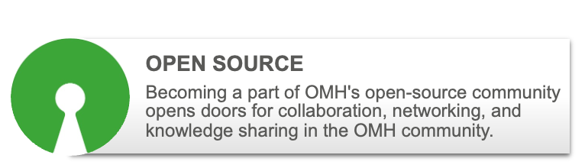
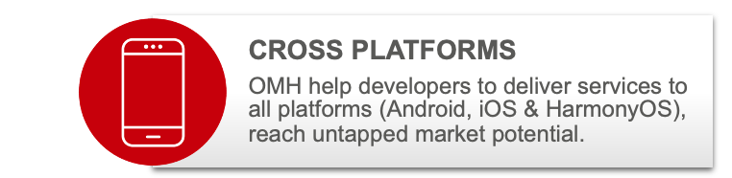
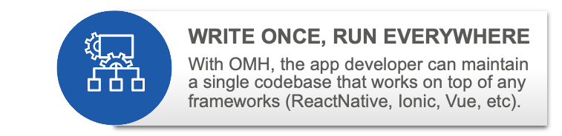
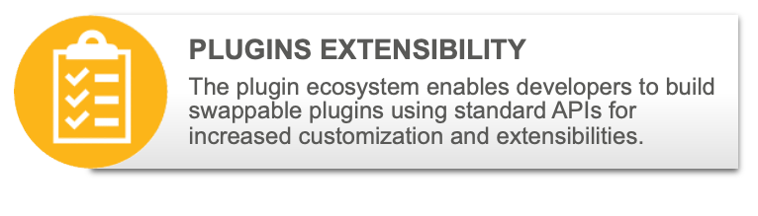















Open Mobile Hub (OMH) Overview
OMH MISSION - Drive adoption of an open mobile ecosystem, enabling developers to utilize framework agnostic libraries to develop device-agnostic applications running on platform-agnostic systems, with plugins extensibility to deliver consistent user experiences on all OS & device types.
Phase 1.0 (2023)
Phase 2.0 (2024)
Phase 2.5 (2025)
Phase 3.0 (2025)
JavaScript Framework
Login Authentication
Share
Location
Cloud Storage / Backup
Mobile Ads
Monetization
Additional Plug-ins
Cloud Storage Backup
In-App
Payment
Push
Notification
Flutter
Support
ArkUI
Support
Notes:
- Include SOW partner for operationalization, maintenance, support, hosting EU companies
- Mention public cloud from GCP, AWS, or Azure
-

Slide 7
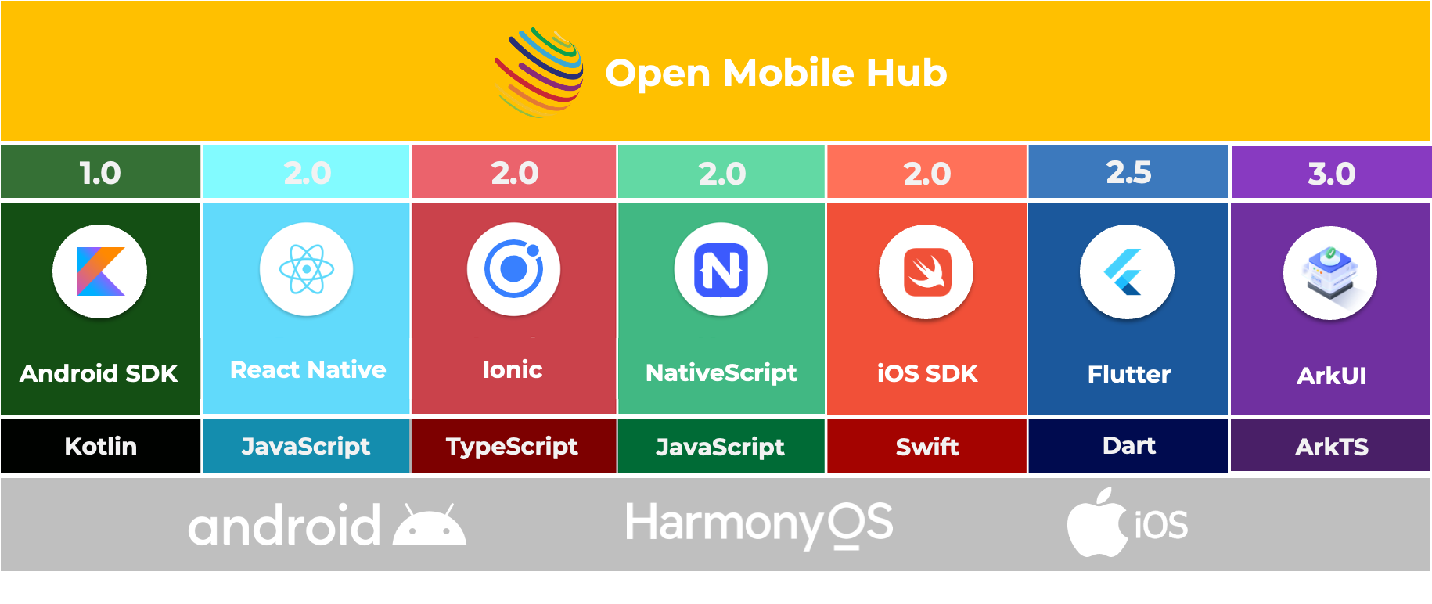
OMH Platform & Framework Agnostic Libraries

Slide 8



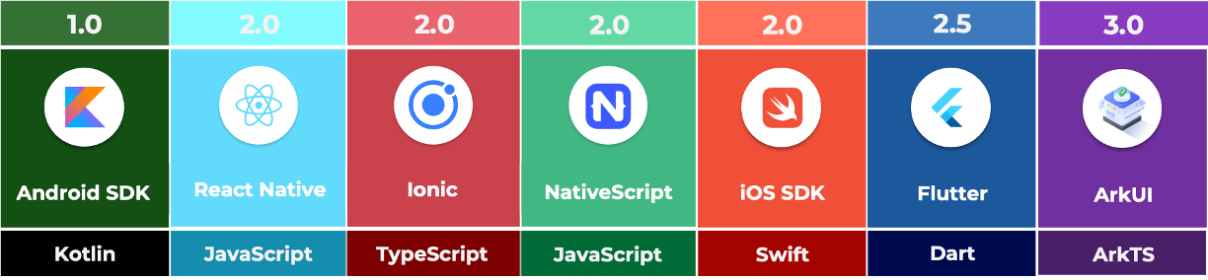
















OMH 2.0-3.0 Future Roadmap
OMH 1.0 Plugins
Mobile Device
Developers App
OMH Platform Agnostic Framework
Auth GMS Plugin
Auth non-GMS Plugin
3P plugins
Google Maps Plugin
OSM GMS Plugin
3P plugins
Google Drive GMS Plugin
GDrive non-GMS Plugin
3P plugins
PayPal Plugin
Square
API
3P Plugin
Authentication API
Maps & Location
API
Cloud & Backup API
Mobile Ads and other API
OMH
Open Source
+
OMH 2.0 Plugins
https://github.com/openmobilehub
Google GMS SDK
HarmonyOS SDK
Apple iOS SDK
+ TV
+ Auto
Device Agnostic
Platform Agnostic
Framework Agnostic
Plugins Architecture
Google private
APIs
Google public
APIs
Other Services APIs
Public Cloud

Slide 9
















OMH Project Timeline
Completed
Planned
Feb 2023
May 2023
Jun 2023
Jul 2023
Sep 2023
Oct 2023
Dec 2023
Mar 2024
Phase 1.0
Project Kickoff
Kickoff work with SOW partner (Encora)
SDK Research & Setup
Maps & Location
Core Plugin
Finish 2 features development
LF Research Whitepaper Draft
Login & Auth
Back & Storage
Finish 2 additional features
Sample apps integration
Phase 1.0 Completed Publish via Github
OMH 1.0 Release
Documentation
Sample apps
Website / Social Media Setup
Bug fixes & updates
Identify Founding Members LF Whitepaper
Intel
Microsoft
Amazon
LF Research Whitepaper publish
Phase 2.0
Features Planning
Finalize 2.0 features & requirements
Include Mobile Ads, JavaScript framework, and iOS Support
12-15 New Plugins
CP OMH Integration
Finalize LF Members
Airbnb
WhatsApp Messenger
Adobe Acrobat Reader
IMDb
Lime
Signal
Wordpress
LF Hosting OMH
Phase 2.0 Kickoff
LF Founding Members confirmed
Transfer OMH to LF for hosting
Kick-Start OMH 2.0 development
1.0 Features
Social Media
2.0 Features & Plug-ins
LF Host OMH
JavaScript Framework
Share
Location
Cloud Storage / Backup
Login Authentication
Mobile Ads
Monetization
Additional Plug-ins

Slide 10
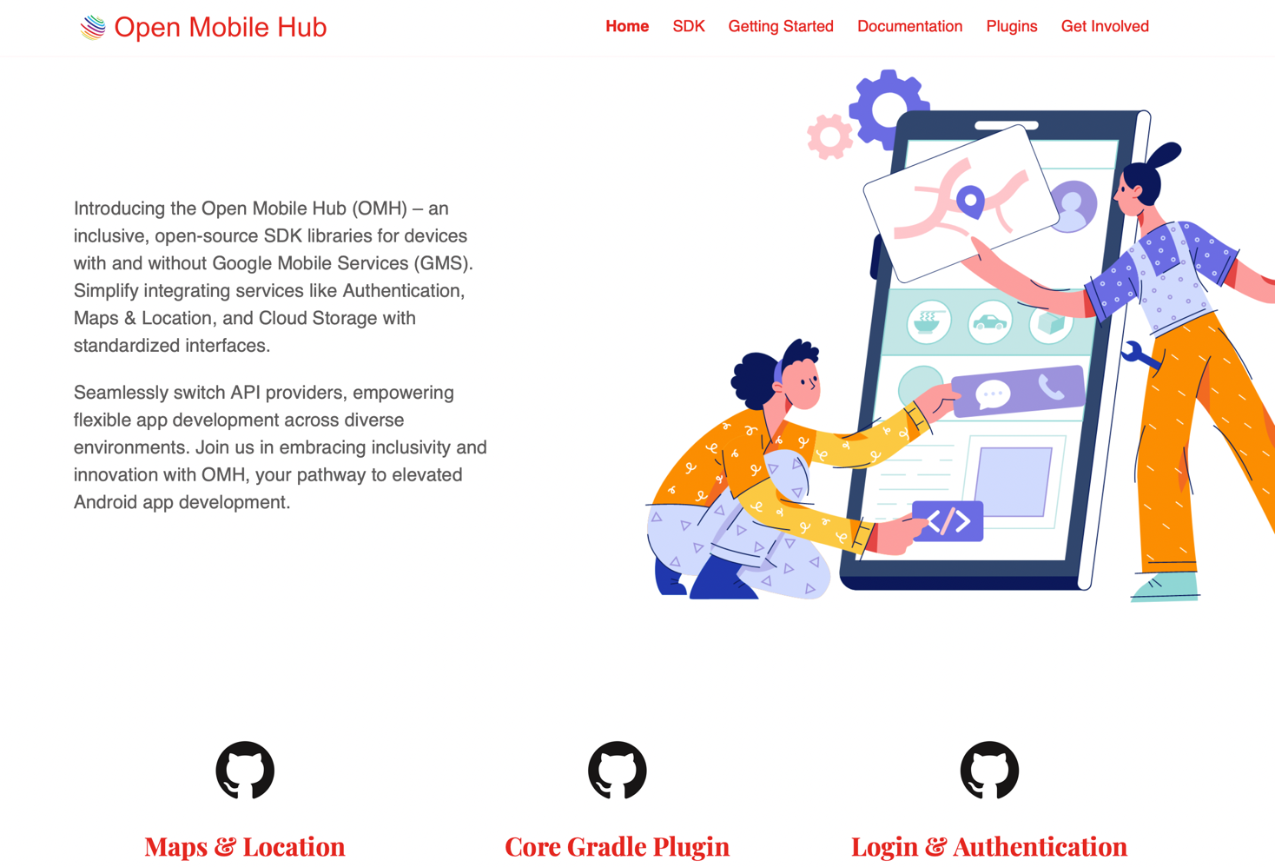
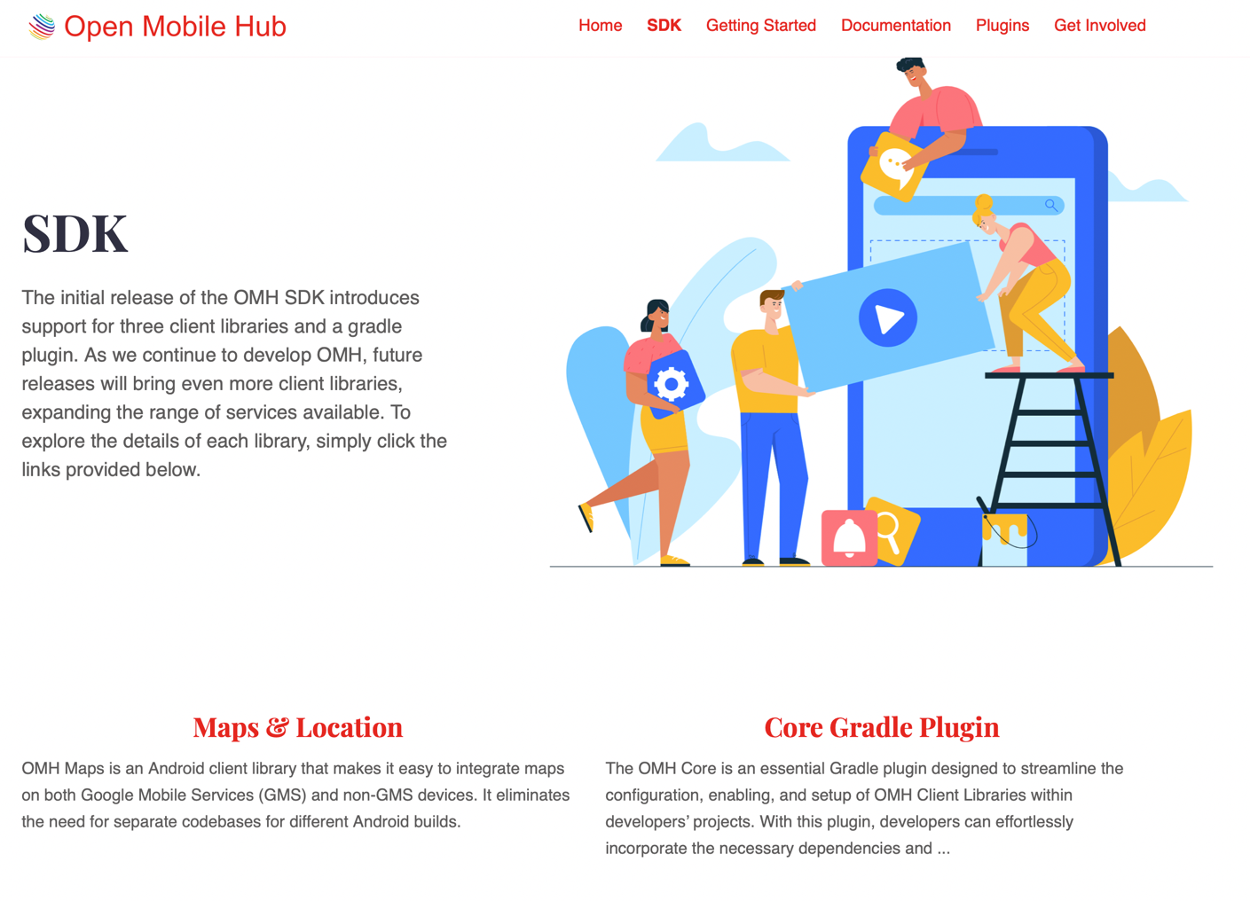
OMH Website
https://www.openmobilehub.com

Slide 11
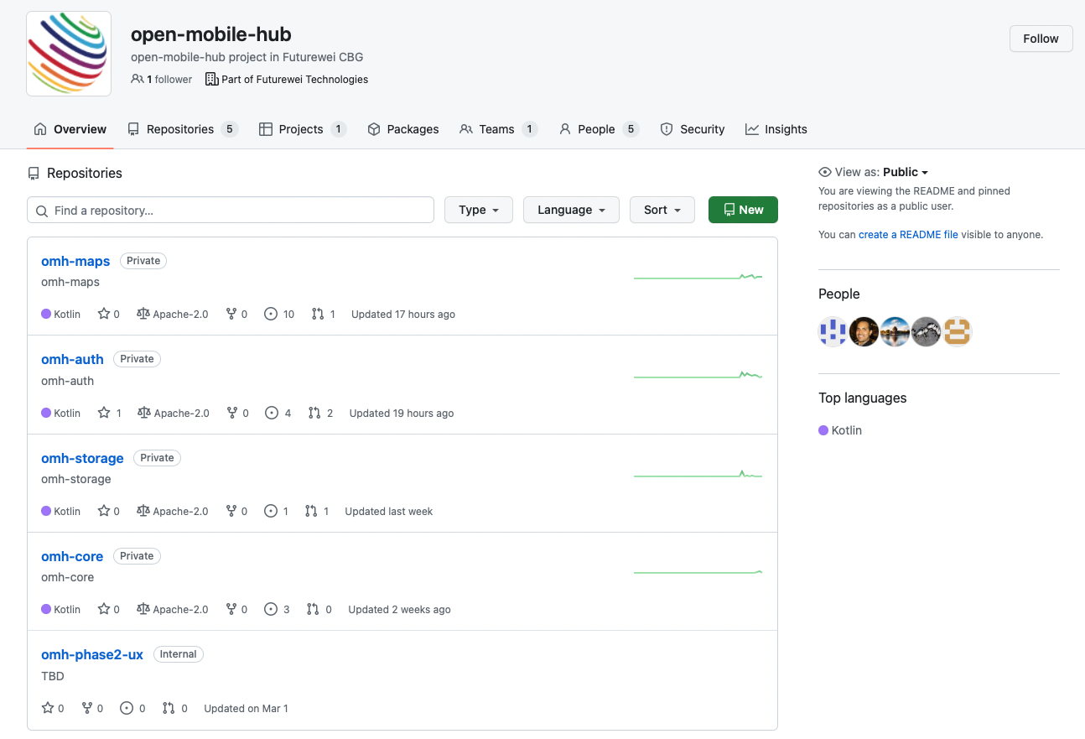

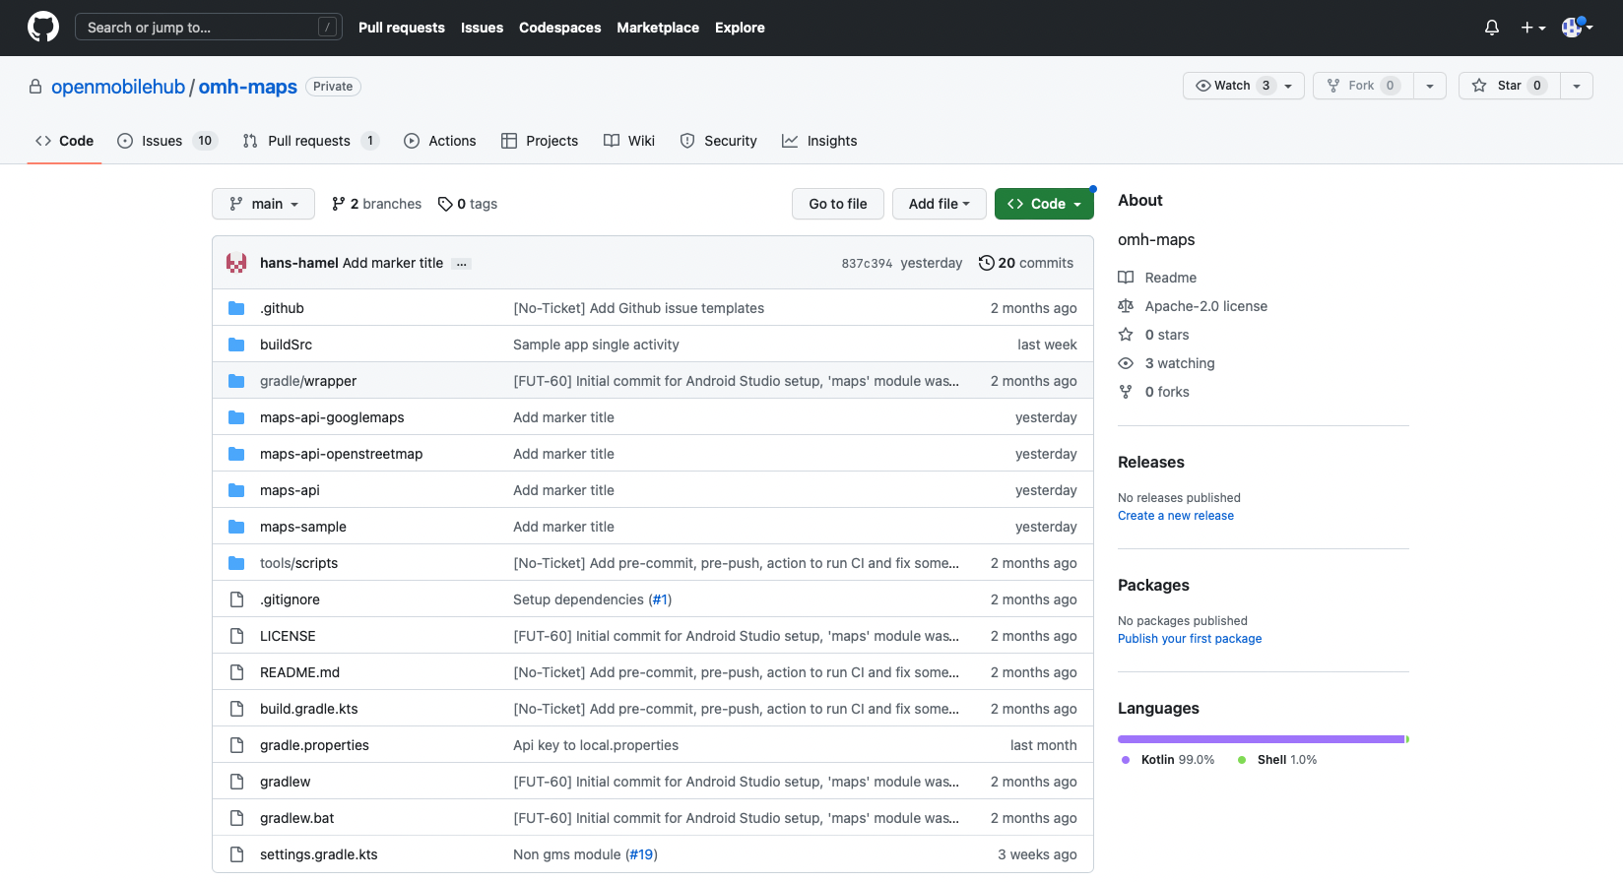
OMH Source Code and Documentation on Github
https://github.com/openmobilehub

Slide 12

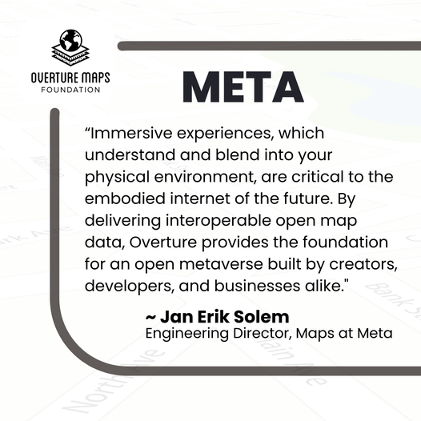


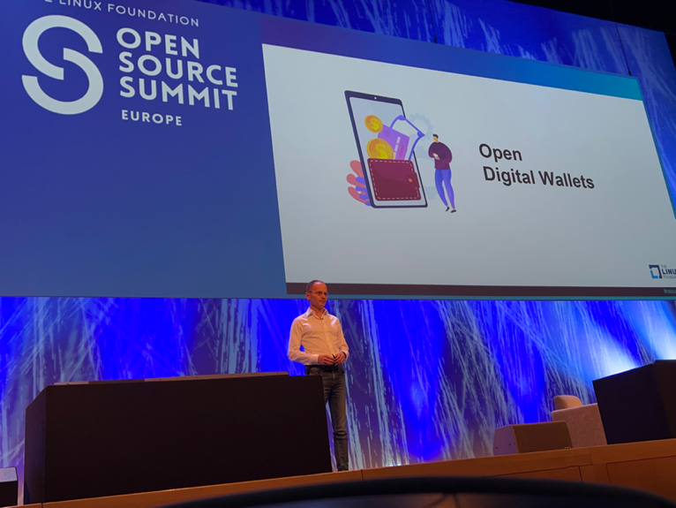




Linux Foundation Research Whitepaper Importance & Benefits of an Open Mobile Ecosystem
30 Pages Research Paper: Focus on understanding the implication of existing laws, regulations, and challenges OEMs, mobile operators, developers and user face; and explore the opportunity to bring an open mobile ecosystem.
Map Building
Global Reference System
Quality Assurance
Structured Data Schema
OpenWallet Foundation: The mission of the OWF is to develop an open-source engine to enable secure and interoperable multi-purpose wallets anyone can use to build solutions.

Slide 13






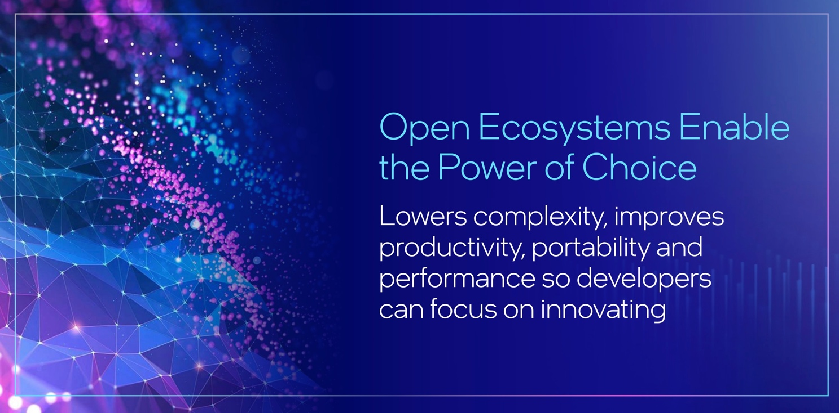
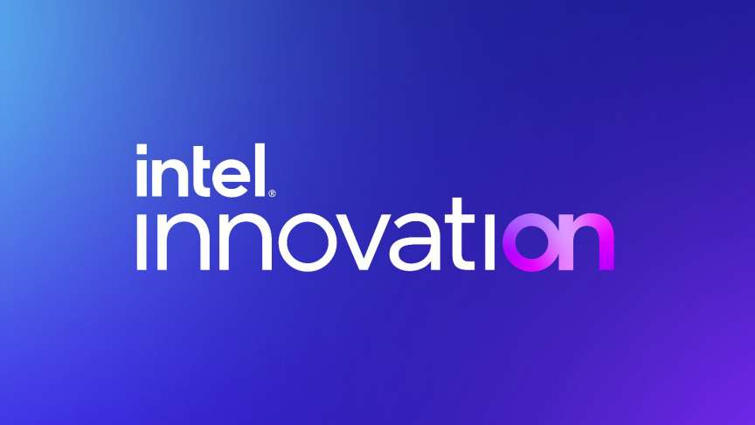
Signal & Intel as Founding Member of OMH Work together to promote adoption of an Open Mobile Ecosystem
+Microsoft & Amazon
Open
Ecosystem
open-source community, standard organizations, and technology partners
Main Benefits as OMH Founding Member
“Our goal is to make it easy for developers to get the best software technology through the open source ecosystem or as Intel-delivered products” - Intel CTO Greg Lavender.
Fully aligned with Intel Open Ecosystem Strategy, enabling the Power of Choice!
Define the technical roadmap of OMH to jointly promote adoption of open mobile ecosystem.
Being main influencers along with other leading open-source organization & communities, particularly in cross-platform mobile & server ecosystems.
Free of charge as founding member.
Notes:
- add Appstore, standards, associations

Slide 14

Linux Foundation Research Whitepaper Importance & Benefits of an Open Mobile Ecosystem
The current mobile industry is dominated by Apple and Google, whose platforms account for 99% of all smartphones sold. Global regulators are coming to see this as a market failure with Australia, India, Japan, Mexico, South Korea, the UK, and U.S. are all writing new regulations to foster a more competitive mobile market.
With all the latest development in the mobile industry, we believe there are major advantages to have an open mobile ecosystem. It would increase innovation, make collaboration more efficient, encourage industry standards and interoperability, and help everyone in the ecosystem adapt to evolving markets and changing environments.

Slide 15
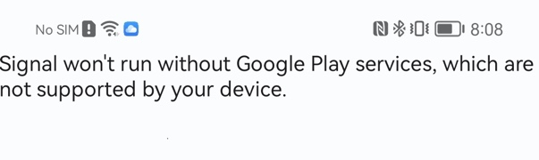
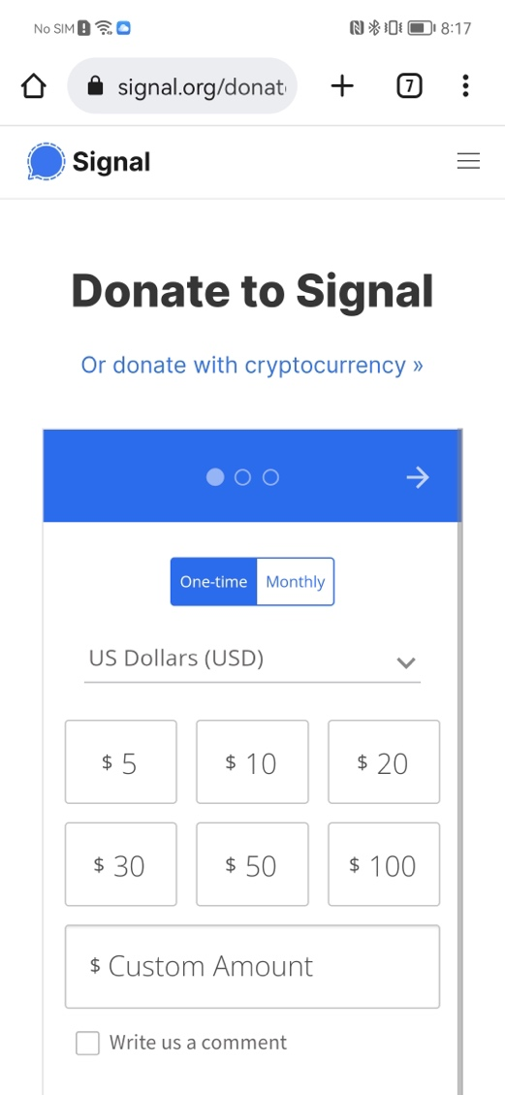


Signal – Google Location, Signup & IAP UX Issues
Google location failed
Google IAP
Signal App UX problems:
Google location failed when users sharing locations
Signup. Use GMS to complete SMS authentication code
Google IAP. For donation, now use Web for IAP
Missing GMS warning
Signal App Partnership:​
Support OMH project as open source founding member.
Use OMH to solve the major UX issues as outlined above, e.g. Maps location sharing
Signal contribute to OMH via open source

Slide 16
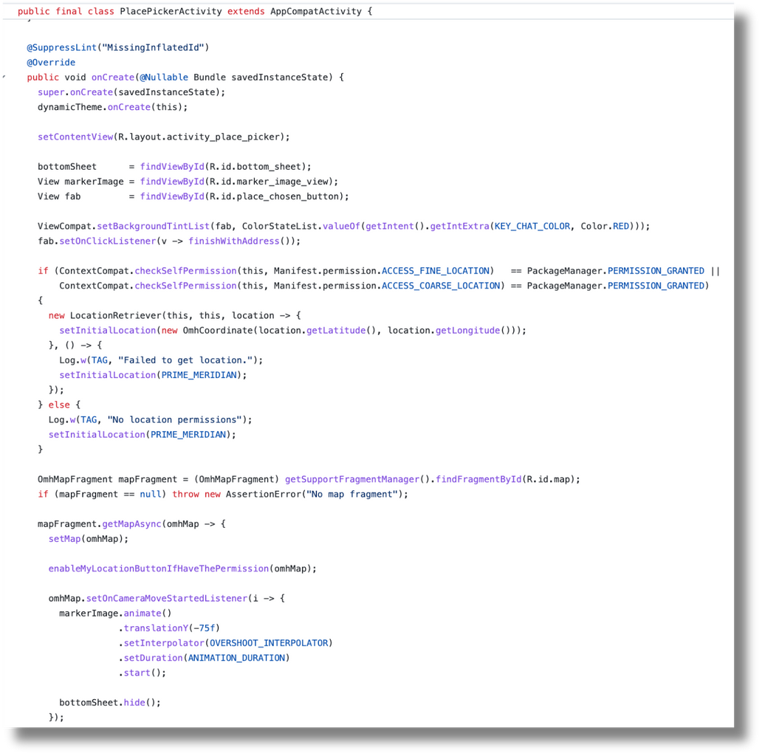
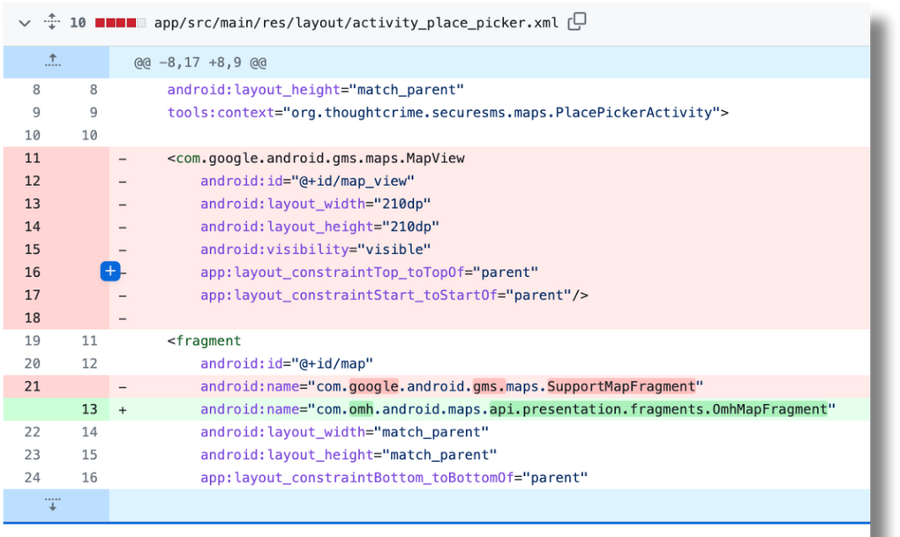
Signal App Simple Source Code Changes to Support OMH

Slide 17
Thank You!

